Slide 1
Visual Saliency Estimation for Binocular Images under a Framework of Inverse Problem
Hao Li
May 10, 2016
Notes:
Hello, every one. Today, my report title is

Slide 2
Outline
Visual Saliency Estimation
Method 1: Bottom-Up Visual Saliency Estimation with Deep Autoencoder-based Sparse Reconstruction
Method 2: Bottom-Up Visual Saliency Estimation for Binocular Images
Notes:
My report introduce the visual saliency estimation for binocular images from three aspects. First, I will introduce some basic concepts and situation in visual saliency field. And second, I will introduce the method from Xia Chen: . Lastly, I will introduce my work.

Slide 3
Visual: Concepts and Terms
Attention: a general concept covering all factors that influence the selection mechanism, whether they are bottom-up or top-down.
Bottom-up scene-driven mechanisms: • physiologically plausible and biologically inspired • Typically, multiple low-level visual features are extracted and combined into a saliency map.
Top-down goal-driven mechanisms: • semantic understanding, memories, state, and task
Saliency: some parts of a scene which are distinctive to their neighboring parts. This term is often considered in the context of bottom-up computations.
Notes:
In Saliency estimation field, we should understand some basic concept as follow. In human visual system, there are two mechanism, one is bottom-up mechanism. Bottom–up saliency, which is scene-driven mechanisms, plays an important part in the selection process and is a perception process for automatic salient region selection for natural scenes. Our research is based bottom-up mechanism. while top-down approach is a task-dependent cognitive processing affected by the performed tasks, feature distribution of targets, and so on

Slide 4
Visual: Applications of Saliency Estimation
In addition to being an interesting scientific challenge, modeling saliency has many engineering applications.
Computer Vision: • Object recognition • Object detection • Image and video compression • Image segmentation
Computer Graphics: • Image rendering • Image thumb-nailing • Automatic collage creation
Others: • Advertising and package design • Robot localization and navigation • Retinal prostheses
Notes:
There are some applications of Saliency Estimation in engineering domain. Such as

Slide 5
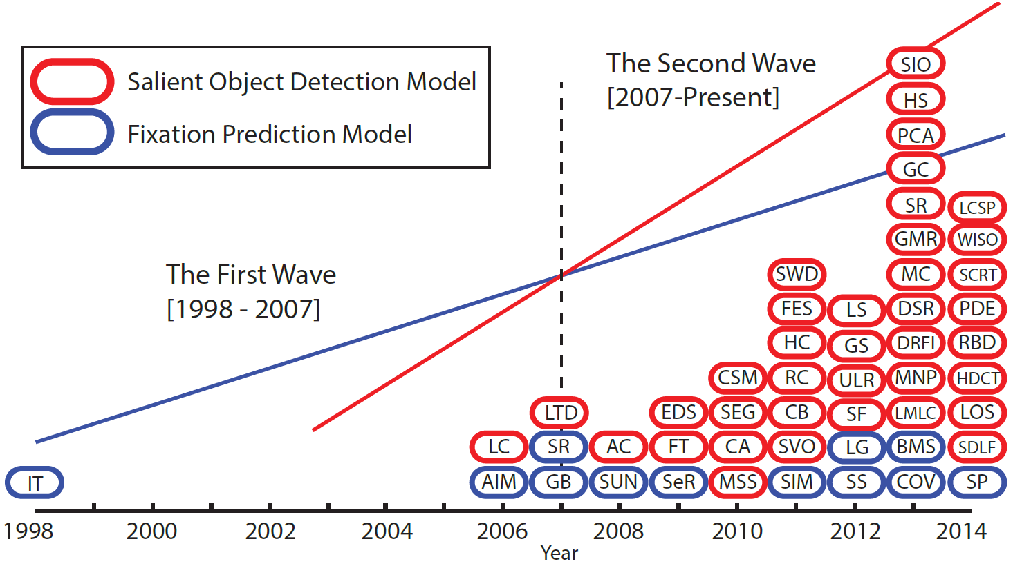
Visual: Classification on Saliency Estimation
Unlike other topics in the computer vision community, saliency estimation is not a well-defined term. • Fixation prediction models • Salient object detection models
Figure: A simplified chronicle of saliency modeling
Notes:
Saliency estimation has two common models. One is salient object detection model, and other is fixation prediction model. we focus on the second one.

Slide 6
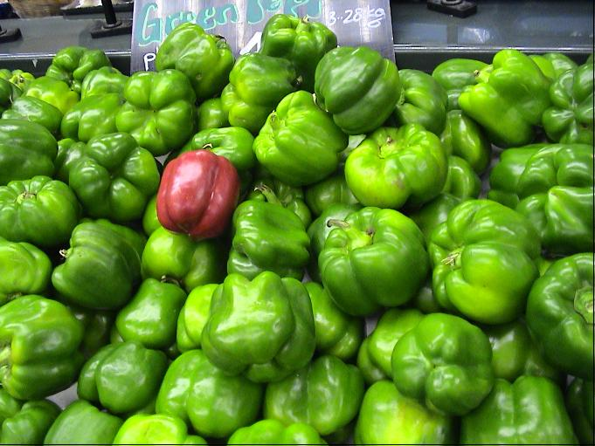
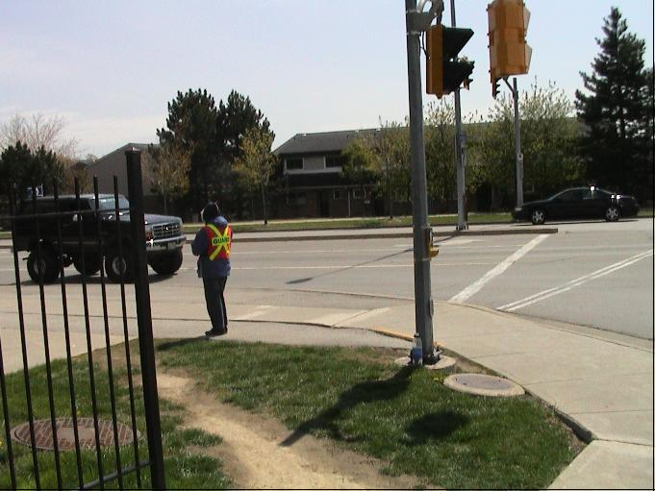
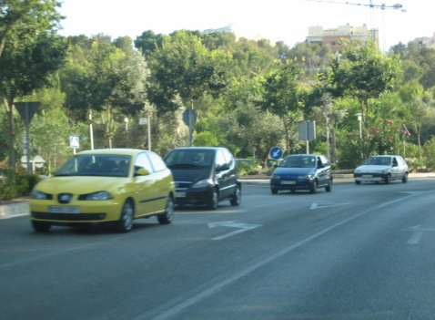

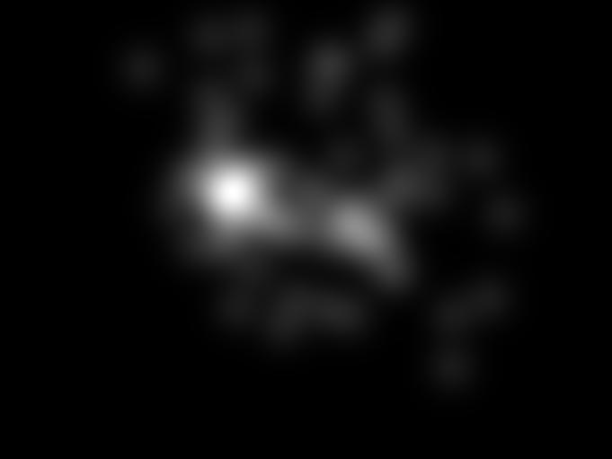


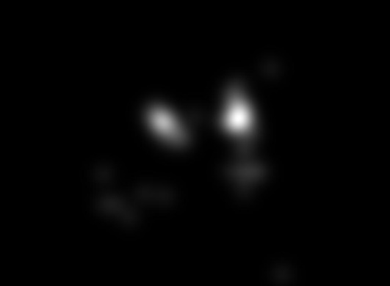
Visual: Classification on Saliency Estimation
Figure: Ground truth for fixation prediction.
Notes:
The fixation prediction Model is the model which find some salient region where people pay attention to instead of object.

Slide 7






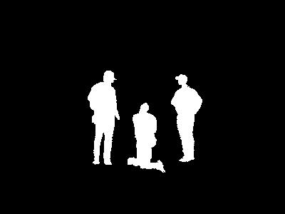

Visual: Classification on Saliency Estimation
Figure: Ground truth for salient object detection.
Notes:
Salient object detection should find the whole salient object.

Slide 8
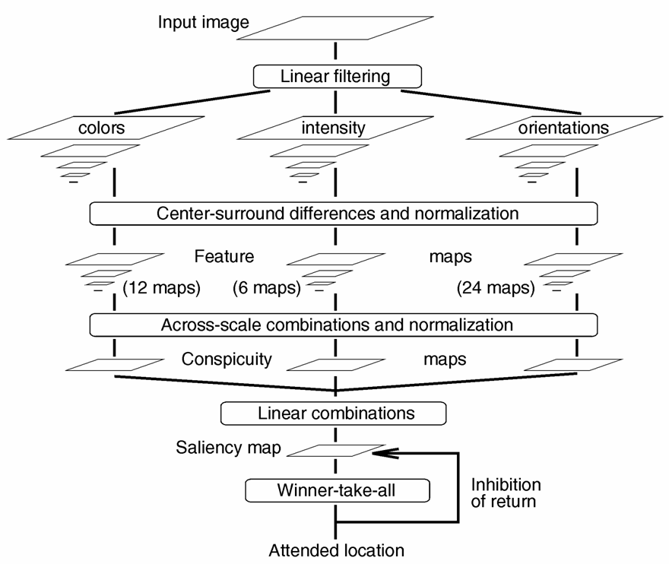
Method 1: The Classical Center-Surround Saliency Model
Figure: Itti et al.’s model.
Notes:
This is an traditional center-surround saliency model. It should extract feature manually, such as colors, intensity and orientations and so on. Then, they calculate all feature maps with center-surround differences. Lastly, they fuse every conspicuity map into the saliency map.

Slide 9
Method 1: Center-Surround Comparison
: a large region around pixel x
: a small area around pixel x
The error vector can well reflect saliency.
Notes:
I would introduce the concept of c-s comparison. We can give the formula to calculate the saliency of pixel x. Given pixel x, we can utilize pi x which is a large area around x to estimate or reconstruct the small area omega x. Then we use p omega x subtracting reconstructed p omega x to get the error vector r(x). P and q are the characteristic quantity corresponding the region.

Slide 10
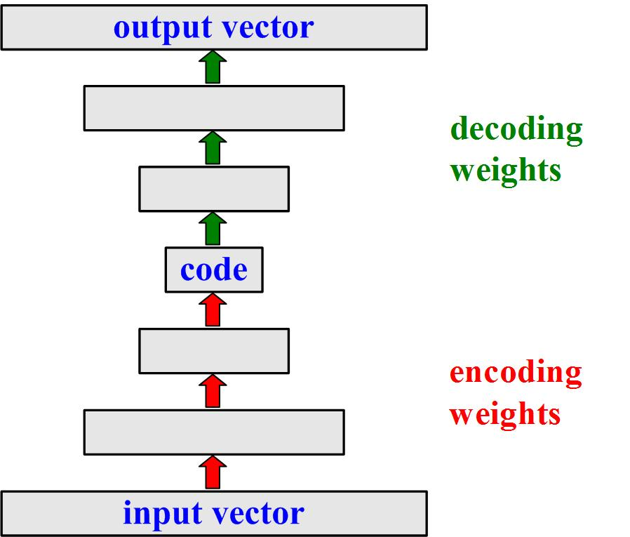
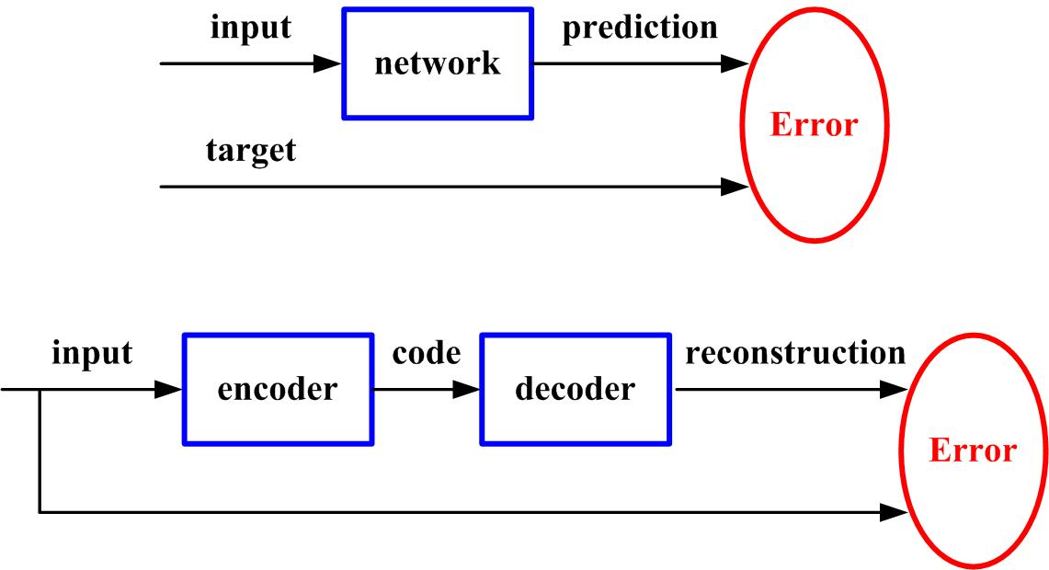
Method 1: Deep Autoencoder
The code vector in the central bottleneck layer can form a compressed representation of the input.
Different from the feature extraction process of CNNs and traditional methods, features can be built directly from the unlabeled data or source image.
(a) Architecture of the autoencoder network.
(b) Comparison with the supervised learning process.
Notes:
Da has two advantages comparing with traditional method for saliency estimation. Because Deep Autoencoder has powerful feature learning and data reconstruction ability, so we should build a deep autoencoder network to reconstruct source images.

Slide 11
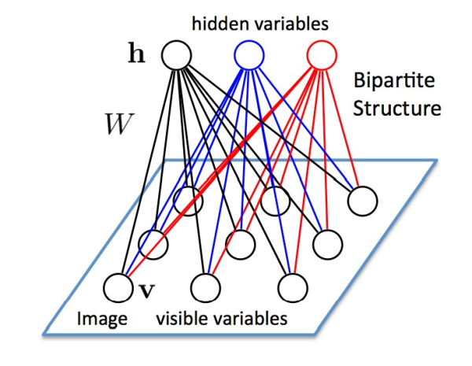
Method 1: Restricted Boltzmann Machine
Each unit is binary.
Every visible unit connects to all the hidden units.
Every hidden unit connects to all the visible units.
There are no connections between v-v and h-h.
Figure: RBM structure
Notes:
Why da has these advantages in reconstruction and learning ability. Let’s see the structure of RBM, it has some uniqueness, first...
Because of these characteristic, It can effectively extract feature. Stacking multiple RBMs can extract more abstract characteristics.

Slide 12
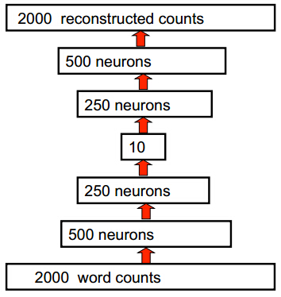
Method 1: Deep Autoencoder
We train the neural network to reproduce its input vector as its output
This forces it to compress as much information as possible into the 10 numbers in the central bottleneck.
Figure: Autoencoder structure
Notes:
You can see that the Deep Auto encoder's encoder layers are stacked by RBMs. And then unroll them to form the decoder layers to build the whole autoencoder network. The function of decoder is that

Slide 13
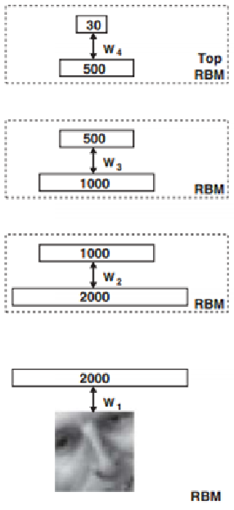
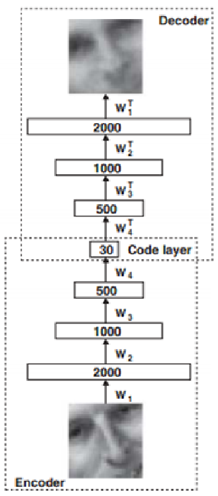
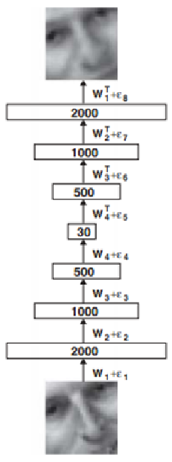
Method 1: Training Autoencoder
Pretraining
Unrolling
Fine-tuning
Notes:
We used a stack of restricted Boltzmann machine to initialize the weights used for encoding, and we then took the transposers of those weights and initialize the decoding network with them. At last, we then applied back propagation algorithm to fine-tuning the weights to minimize the reconstruction error.

Slide 14
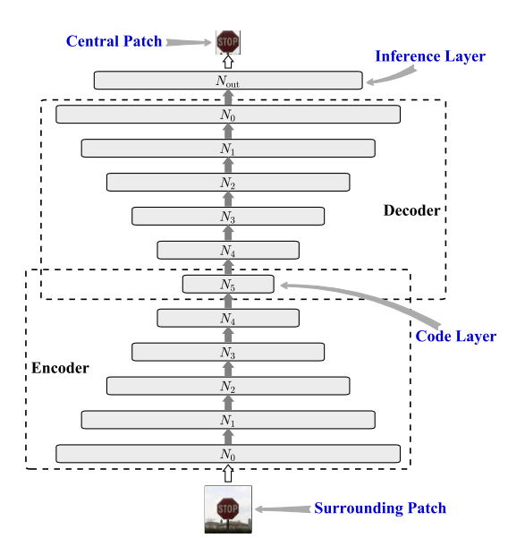
Method 1: Deep C-S Inference Network
Figure: Deep C-S inference network structure
Notes:
Our C-S inference network, comparing with common autoencoder network, we add an inference layer on the output of decoder layer, this purpose is that we input a large patch around the pixel x and get a small patch around x.

Slide 15
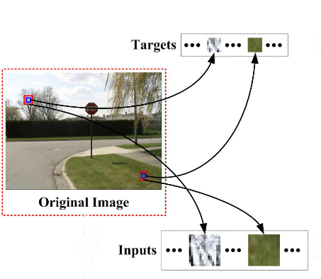
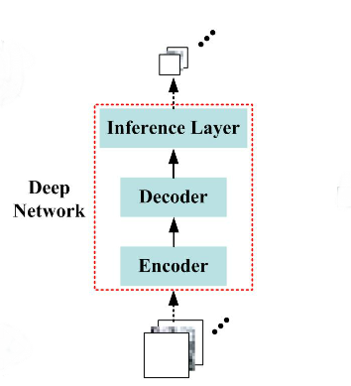
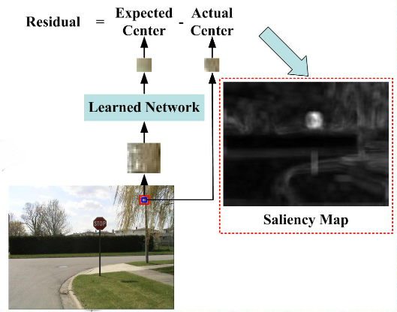
Method 1: saliency estimation algorithm
Figure: Diagram of the saliency estimation algorithm.
Notes:
First, pairs of surrounding (red patches) and central patches (blue patches) are randomly sampled from the original image according to a uniform distribution. Then, the C–S inference network is trained with the sampled data as inputs and corresponding targets. Finally, the learned network is applied on each region of the input image to predict the center and compare it with the actual center to estimate unpredictability and saliency

Slide 16
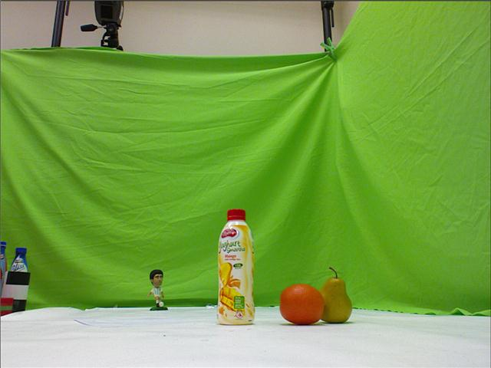

Method 2: RGB+D Saliency Estimation
R
G
B
D
+
Figure: RGBD.
Notes:
There is an new approach to estimate the saliency, with using GGB+D image. Left image is a common rgb image, and the right image is depth image. Stereopsis provides an additional depth cue and plays an important role in the human vision system. Previous studies from neuroscience indicate that the depth feature would cause human beings’ attention focusing on the salient regions.
So, many method using depth information were proposed.

Slide 17
Method 2: RGB+D Saliency Estimation
RGB
image
RGB Saliency Map
RGBD dataset
Fusion
Final Saliency Map
Depth
image
Depth Saliency Map
Figure: Traditional RGB+D Saliency Estimation Model
Notes:
This is a classical RGBD saliency estimation model. This is explicit use of depth information.

Slide 18
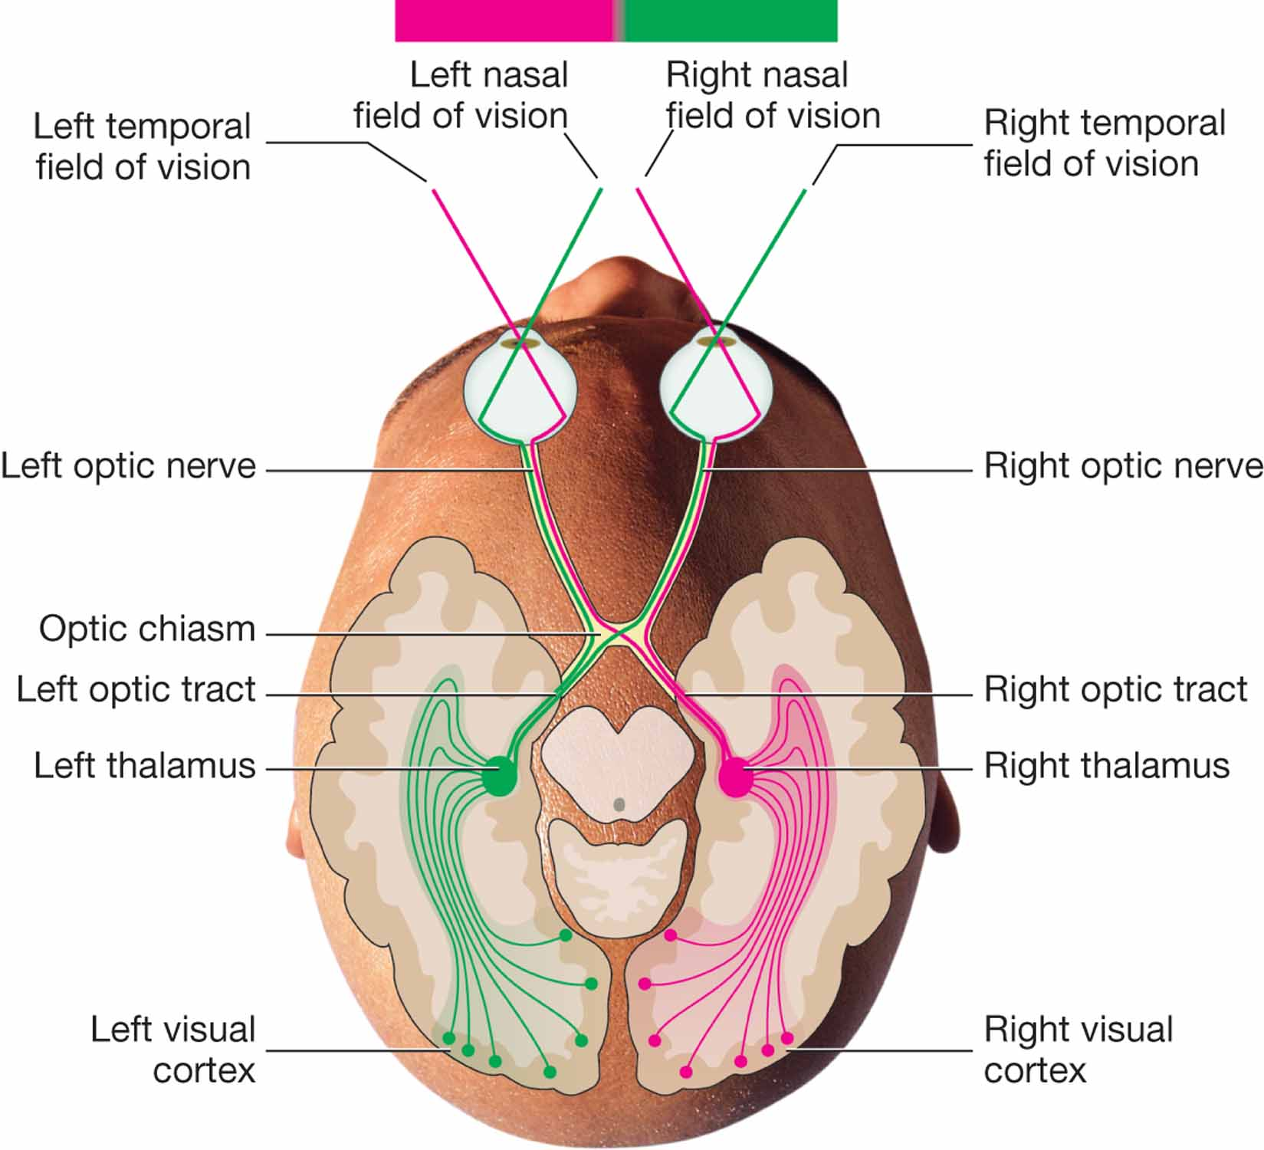
Method 2: Binocular Images Saliency Estimation
human visual system can't perceive the depth of the image information directly and accurately.
left and right eye visual signals merge together after a long visual pathways.
Figure: Optic chiasm structure
Notes:
Let’s see the optic chiasm structure image. Under the support of optic chiasm structure, binocular image studies models respectively, then we use cross reconstruction error to estimate saliency.

Slide 19
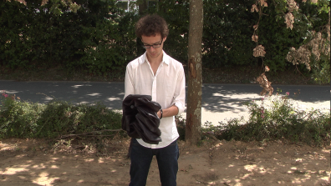

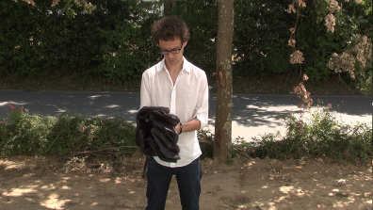
Method 2: Binocular Images Saliency Estimation Model
Left View
Saliency Map 1
Sampling
Network Training
Saliency Estimation
Saliency Map
Saliency Map 2
Saliency Map 3
Sampling
Network Training
Saliency Estimation
Saliency Map 4
Right View
Figure: Diagram of binocular images saliency estimation algorithm
Notes:
Concretely, We samples patch from left view images to train c-s inference network, then we input left view and right view images respectively into the trained network to get two saliency maps. Then, similarly, we use right view images to train other c-s inference network, then ...we fuse the four saliency maps into the final saliency map.

Slide 20
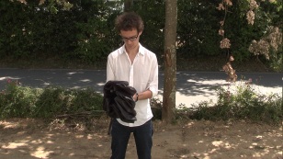










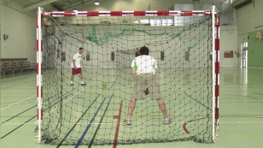
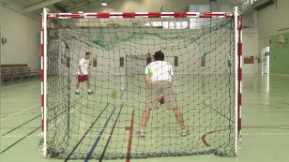


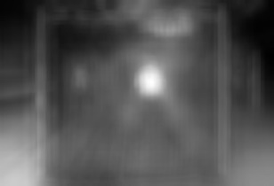






Method 2: Experimental Results
Left View
Right view
Truth
LL
LR
RL
RR
Notes:
The first column is .the fourth column is that use left view image to train the network and reconstruct left view image.
We can see the forth reconstruction situations mainly detect the saliency region, and the LR and RL images is slightly better than LL and RR.
And we can see in the non-salient region, the reconstruction ability is different, and how to fuse the four saliency maps to emphasis the salient region and decrease the reconstruction error in non-salient region is the important work subsequently.

Slide 21
Thank you !

